Slide 1
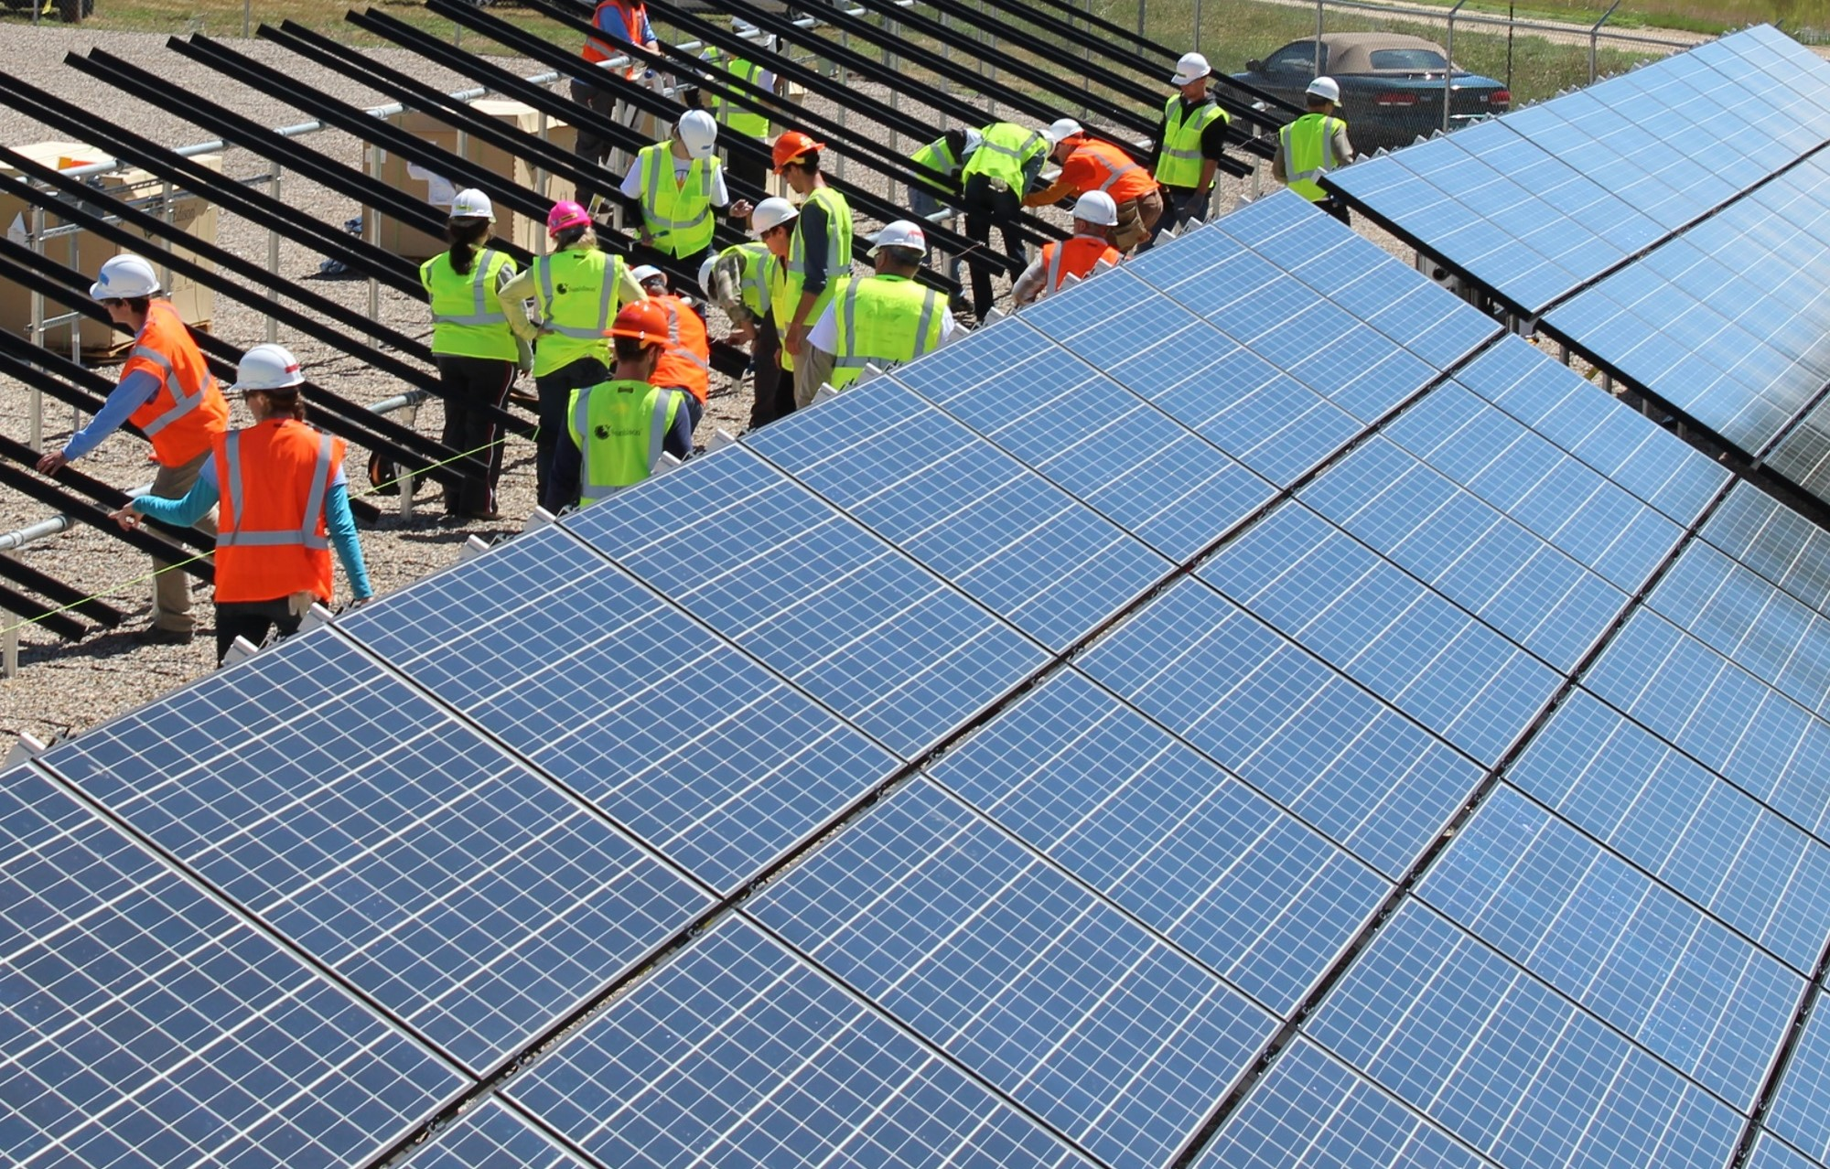
Community Solar Roundtable
June 2022
‹#›
Notes:
Ken - Introductions

Slide 2
Contents
Overview of the program (BB)
Low-Income participation and recommendations (CC)
CCSA: RFP points, developer perspective on LI/CBOs (KC)
GRID: Experience working with LI, tribes, local governments (TF)
Santa Fe Co: Addressing land use issues by example (JB)

Slide 3
200 MW Statewide Program Cap
Initial statewide program cap of 200 MW over the first 3 years of the program within investor-owned utility (IOU) service territories
Cap, allocated proportionally: 125 MW PNM, 45 MW Xcel Energy (SPS), 30 MW El Paso Electric until Nov 1, 2024
Tribes and Rural Electric Cooperatives excluded from a capacity cap
After Nov 2024, annual cap will be set by PRC as part of programmatic review and recommendations

Slide 4
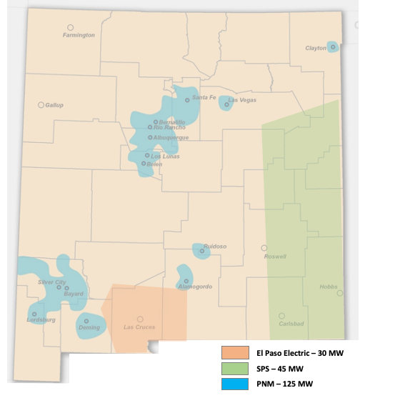
Areas covered by IOUs in Community Solar Act
PNM serves 540,000 customers
EPE serves 100,000 customers
SPS serves 115,000 customers

Slide 5
Electric Coop, Tribal Participation, Munis
Rural electric cooperatives are exempt from participation in the program unless they decide to opt-in
Tribes and Pueblos have sovereign jurisdiction over their lands
Tribes can develop community solar projects without many of the program restrictions (e.g., size, anchor tenants, etc.) - will be easier for tribes in IOU service territory.
Tribes can benefit from anchor tenants located outside of their community
Munis can use CS framework to develop another program that meets their needs
Notes:
Coops: on a per project or service territory-wide basis and at sole discretion of their governing boards.
Tribes stand to benefit from CS legislation thru econ development and lowering disproportionate energy costs borne by tribal communities
Munis: bill silent.. Can certainly use framework from PRC to come up with another program with more flexibility.

Slide 6
5 MW Facility Cap
Each community solar facility must have at least 10 subscribers
No more than 40% can be used by single subscriber (anchor tenant)
Can be local governments, non-profits, schools/community colleges, churches, and housing authorities
40% of the generating capacity of each community solar facility reserved for subscriptions less than 25 kW to ensure access to residents and small business-owners
Subscribers & community solar project facility must be within same utility service territory
Option of co-locating with other energy resources, but not with other community solar facilities if site subdivided within 2 years, or without PRC approval
Notes:
Site cannot have been subdivided within last 2 years

Slide 7
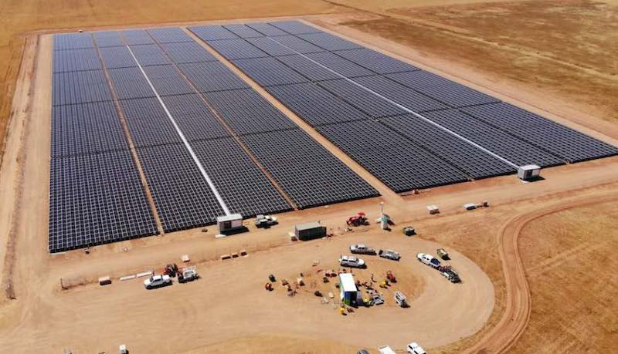
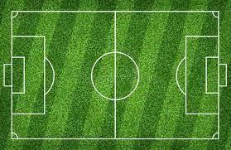
Example of a 5 MW Community Solar Facility
It would take up about 30 acres (or 30 soccer fields)
Notes:
How many households would be served by 5MW facility in this example?
It can be misleading to think in terms of households, because likely ~ 30% or less of the capacity will be serving households. Ave household will be served with about 4 kW production, so about 1250 households could be supported by the solar production from a 5 MW array in NM. Likely 250-350 households will likely end up being subscribers, with anchor tenant, low-income serving orgs, and small commercial subscribers

Slide 8
Example of a 5 MW Community Solar Facility Subscriptions
Up to 40% (2MW) can be a single anchor tenant, like a school, local govt
May see up to 50% (2.5 MW) LI:
30% (1.5 MW) filled by LI serving orgs
20% (1 MW) filled by 285 LI households
10% (0.5 MW) filled with non-low income households and small businesses
40% Anchor Tenant
10% - Homes & Commercial
30% - Low Income Serving Organizations
20% - 285 Low Income Households

Slide 9
What are the climate benefits?
Avoids the equivalent amount of CO2 produced by 800 cars in 1 yr
5 MW Solar Facility
3,800 metric tons of CO2 would be avoided in 1 year with a 5 MW solar facility on PNM’s grid 2022
Calculation based upon assumption that average NM grid emission is 0.43 tCO2/MWh, and 4.6 tCO2 emission/year per car

Slide 10
Subscriber protections NM
Includes a uniform disclosure form and a subscriber agreement.
Uniform Disclosure:
Identifies information provided to potential subscribers, in English and Spanish, and possibly native or indigenous languages
Ensures fair disclosure:
future costs and benefits of subscriptions
key contract terms
other relevant information pertaining to the subscription
grievance and enforcement procedures
Notes:
Provided by Subscriber Organization
“Security Interests”

Slide 11
Subscriber Agreement NM
Subscriber organization shall develop and implement written subscriber agreement containing the organization’s terms and conditions for subscribing to its project
A. Subscriber agreement must include, at a minimum:
(1) general project information;
(2) effective date and term of the agreement;
(3) identification of all charges and fees;
(4) payment details;
(5) information about bill credit mechanism;
(6) comparison of the subscriber’s net bill with and without the subscription;
(7) terms and conditions of service;
(8) process for customer notification if community solar facility is out of service;
(9) customer protections provided;
(10) contact information for questions and complaints; and
(11) subscriber organization’s commitment to notify subscriber of changes that could impact her

Slide 12
Low-Income Participation
30% of each project capacity reserved for LI customers and LI service organizations
“Low-income customer” means a residential customer of a qualifying utility with an annual household income at or below 80% of the area median income level as published by the US department of health and human services
or participating in an approved low-income program
or as defined by the commission
"low-income service organization" means an organization that provides services, assistance or housing to low-income customers and may include a local or central tribal government, a chapter house or a tribally designated housing entity
Notes:
Christian

Slide 13
Low-income qualification
Automatic qualification:
Medicaid; (133% of Federal Poverty Level, FPL)
Supplemental Nutrition Assistance Program (SNAP) (130% of FPL)
Low-Income Home Energy Assistance Program (LIHEAP) (150% of FPL)
First-time homeowner programs and housing rehabilitation programs
Living in a low-income/affordable housing facility
Other ways to qualify:
80% of area median income with confirming documentation
The commission can develop a list of LI service organizations that can pre-qualify low-income customers……
Notes:
Self-attestation is best practice
Documentation could include:

Slide 14
Potential Challenges…
Meaningful savings for low-income subscribers is important for program success
Monthly savings need to be communicated clearly
Having two bills may be confusing/a barrier for some households (Consolidated billing off the table for now)
CBOs/Subscribers need to have an easy/accessible way to compare offers in different projects
Signing up needs to be easy - especially for people with additional barriers (without bank account or credit cards, undocumented)
Self attestation allowed but with documentation (needs clarification)
Notes:
CC or Tom

Slide 15
Best Practices for Low-Income Solar Customers
Meaningful monetary savings and minimal barriers to enrollment (including self-attestation)
Remove financial barriers: no upfront costs and termination fees
Partnerships with local organizations that are trusted by low-income communities through clear and meaningful contractual relationships
Continued allocation of resources to community-based organizations for outreach to, training for, and bringing on board low-income customers
Clear and transparent communication through a centralized website
CBOs/Subscribers need to have easy/accessible way to compare offers
Notes:
CC

Slide 16
Implementing Community Solar in NM Project Selection
A. The commission shall engage a third-party administrator to manage a process for selection of community solar facilities
B. Community solar projects shall be selected through a competitive solicitation process, with bids meeting minimum requirements. Eligible bids must be scored upon a set of non-price criteria and must include the following:
(1) legally binding site control;
(2) commitment to meeting or exceeding all statutory subscriber requirements,
including minimum 30 percent low-income subscription requirement,
(3) any required, non-ministerial permits have been issued to bidder at the time bid is submitted,
(4) $1000 application fee.
C. Competitive solicitation process must include the following preferences to benefit local community and state of NM
(1) businesses residing in the state and for resident veteran businesses,
(2) projects supporting local businesses employing local labor, or having partners resident in the state;
(3) bids including workforce training or educational opportunities for disenfranchised groups;
(4) businesses owned or operated by minorities or women;
(5) bids including local job training or committing to long- term jobs in New Mexico; and
(6) bids including partnership with local communities or community-based project ownership.
Notes:
Kevin

Slide 17
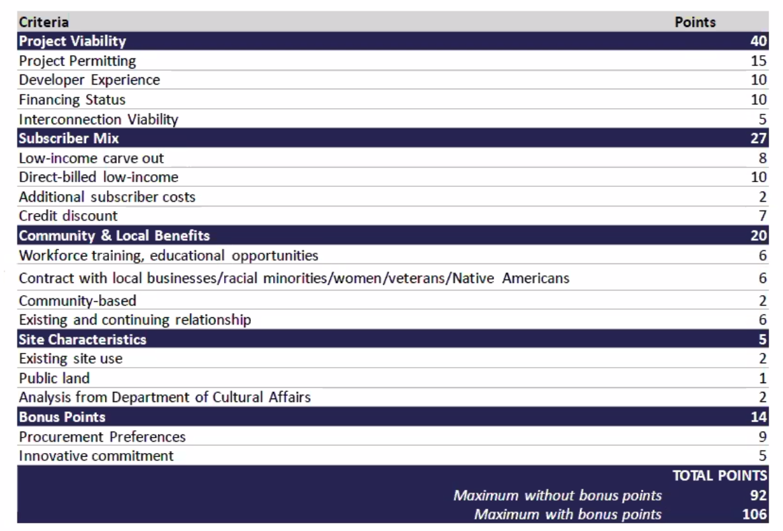
Implementing Community Solar in NM
Project Selection Criteria (subject to change)
Notes:
Kevin
Cadmus recommended this to the PRC under their contract
STRESS THE PARTNERSHIPS INCENTIVIZED FOR WORKING WITH AND FORMING PARTNERSHIPS WITH LOCAL GOVERNMENTS
WORKSHOP WITH LOCAL GOVERNMENTS ISSUING PERMITS FOR COMMUNITY SOLAR; COMMISSION WILL WANT TO SEE TO AWARD POINTS
PRC accepted most of Joint Commenters’ suggestions: CCSA (lead), Coalition, Vote Solar, GRID, CVNM
Program Administrator will be selected shortly to issue RFP

Slide 18
Status of Rules, PRC Process
RFP process should be finalized shortly
Program Administrator will be announced shortly to administer the selection process as well as the program
Final Rules are scheduled to be published on July 12, establishing their effective date
PRC will participate in a national program pilot of DOE’s Office of EE and RE: LIHEAP Community Solar Subscription Platform
Notes:
Kevin

Slide 19
Working with Local Governments and Low Income customers
Developer Perspective
Local governments can play a role in education and outreach about the program
Perspective on what they would want in working with local governments
Workshop with local governments issuing permits for Community Solar; what the commission needs to see before issuing points in the RFP
Notes:
Kevin

Slide 20
Working with Local Governments and Low Income customers
GRID’s Experiences
Working with local governments
Working with low-income and tribes
How local government participation can provide benefits for low-income
Notes:
Tom

Slide 21
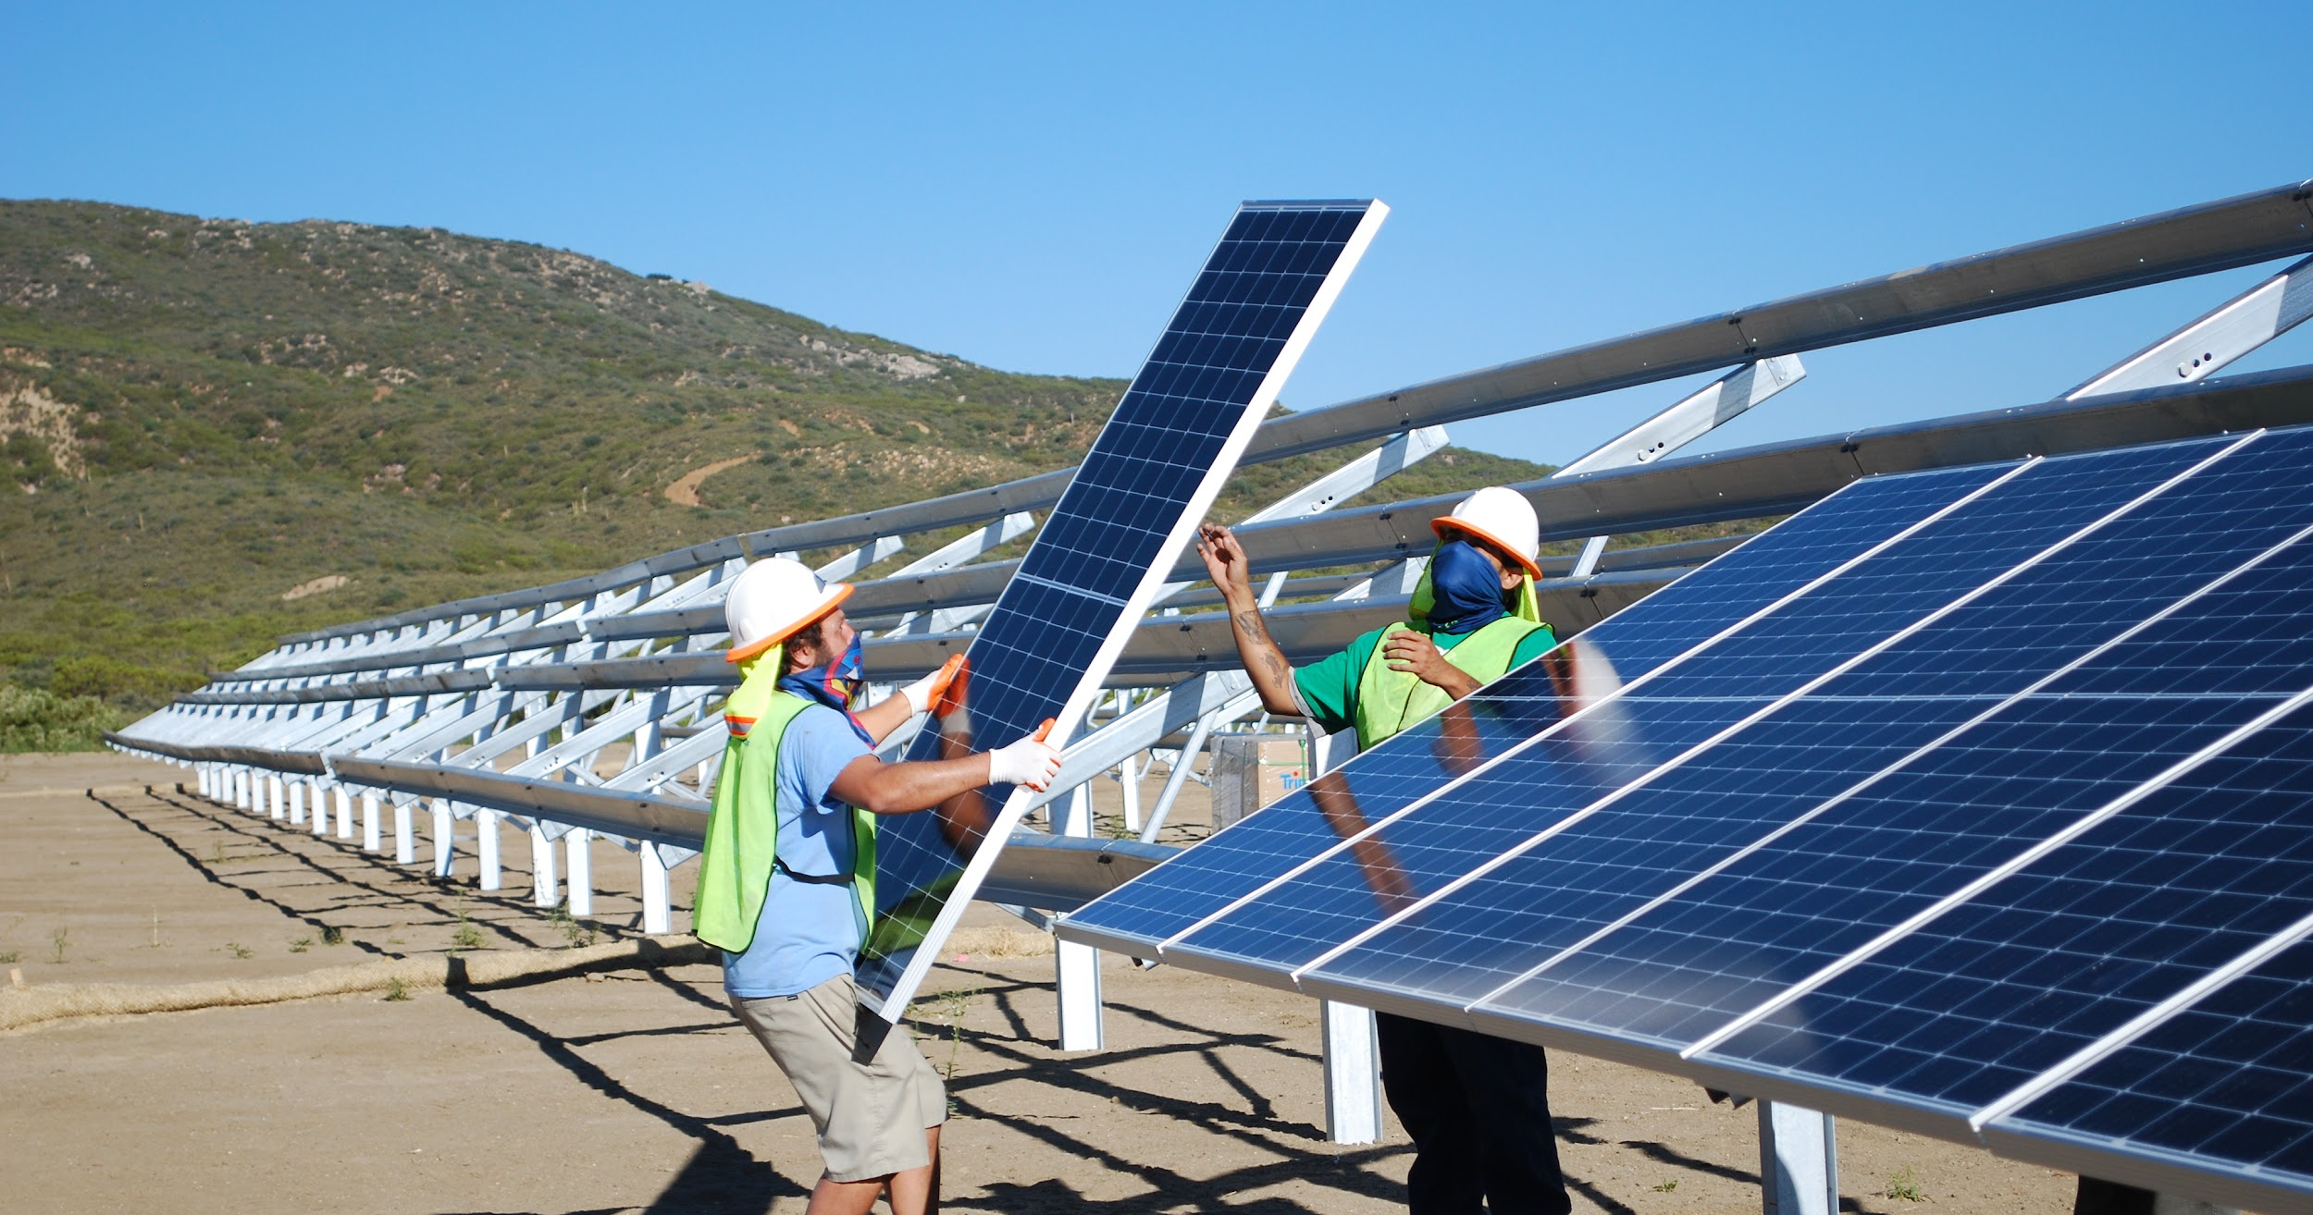
GRID Alternatives
GRID Alternatives is a 501(c)3 national nonprofit that envisions a rapid, equitable transition to a world powered by renewable energy that benefits everyone. Our mission is to build community-powered solutions to advance economic and environmental justice through renewable energy

Slide 22
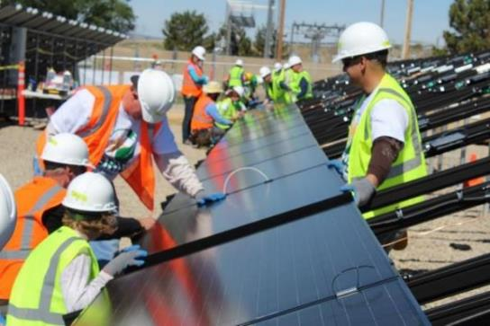
GRID’s work in Community Solar
Leading developer of low-income, Tribal, Environmental Justice (EJ) and workforce development focused community solar projects
Project development, program design, policy and regulatory engagement, utility partnership
Core focus: Low-to-Moderate Income (LMI) customer and EJ impact, workforce development, Tribal projects
Community partnerships and technical assistance
17 projects to date, over 12.5 MW installed, 20+ MW pipeline
Projects & partnerships: CO, CA, MS, OR, WA, DC
Developed first Tribal community solar projects (Ute Mountain Ute, Santa Rosa Band of Cahuilla)

Slide 23
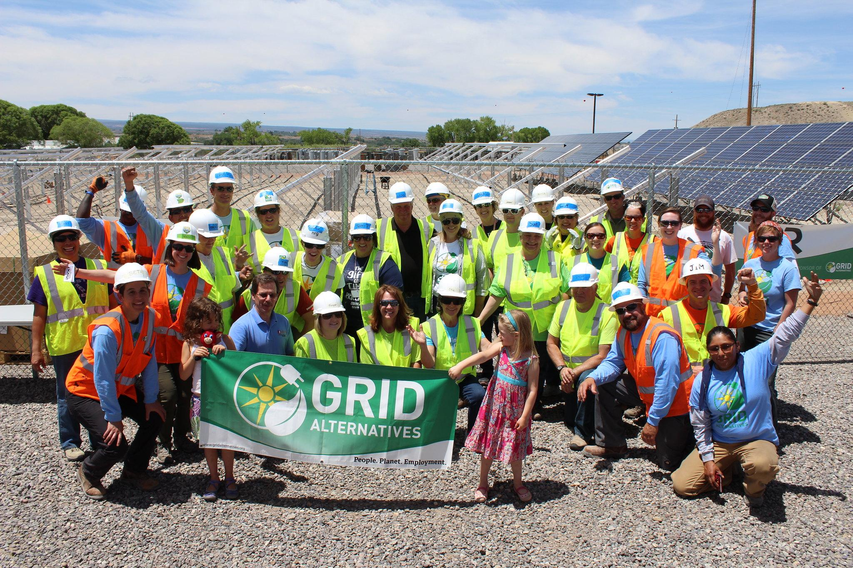
GRID’s work in Community Solar
Subscribers
Low-to-moderate income households up to 80% of AMI (goal: reducing electric energy burden)
Affordable Housing (public housing authorities) and nonprofits
Cities (anchor subscribers, siting & dev partnerships)
Subscriber Type | Project Subscription Capacity | Number of subscribers | % of current GRID projects
LMI | 5.4 MWs | 1,415 | 44%
Affordable Housing & Nonprofit | 5.2 MWs | 128 | 42%
Cities | 1.8 MWs | 32 | 14%

Slide 24
Partnership with Cities
Siting
Project Development
LMI subscriber management
Workforce training
K-12 solar curriculum
Policy & Planning
Example:
Partnership with City of Denver, Mckinstry, GRID Alternatives combining climate and community solar benefits.
Aggregated siting for up to 15 MW of community solar
Minimum 20% low-income customers to alleviate energy burden
Paid local workforce training by GRID, training curriculum through Denver Public Schools
Denver plays an active role competing for / developing projects
Notes:
https://cityrenewables.org/story/denver-co/
https://gridalternatives.org/what-we-do/workforce-development/solar-futures

Slide 25
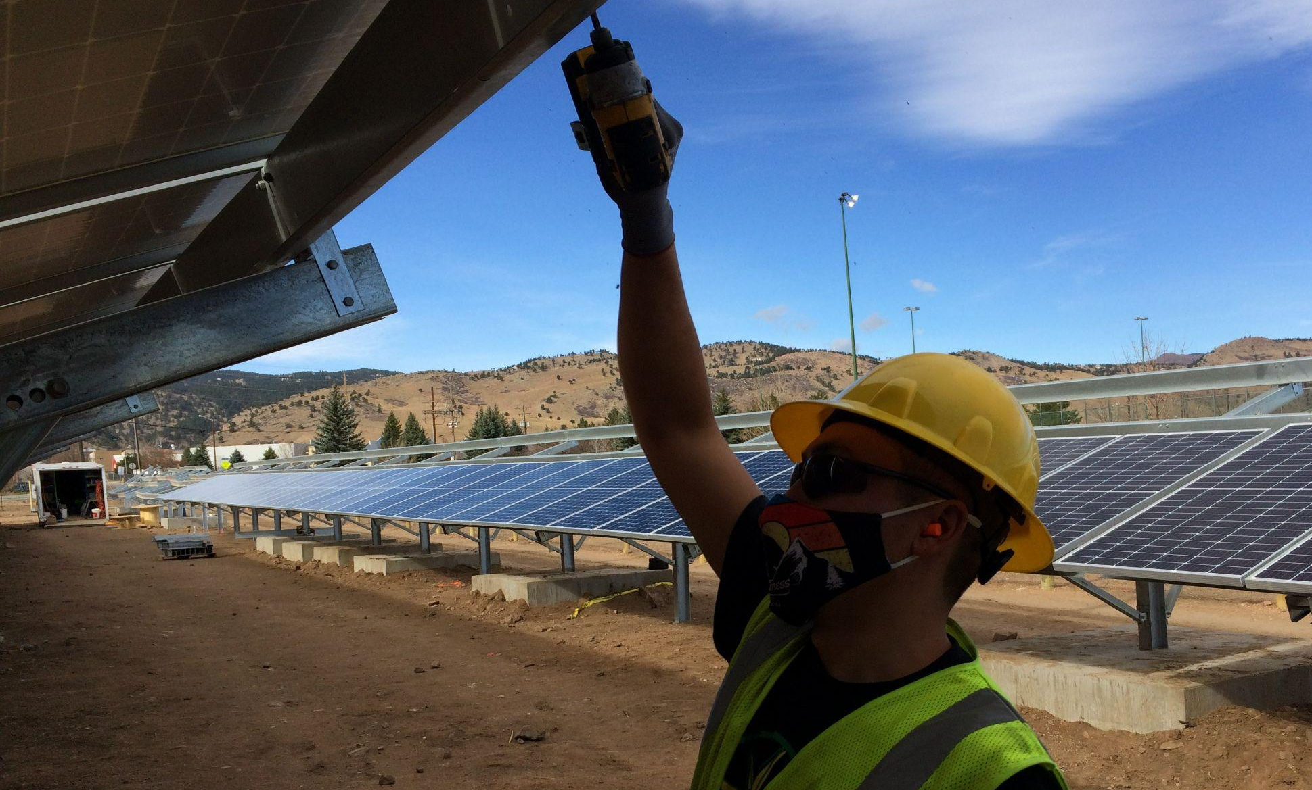
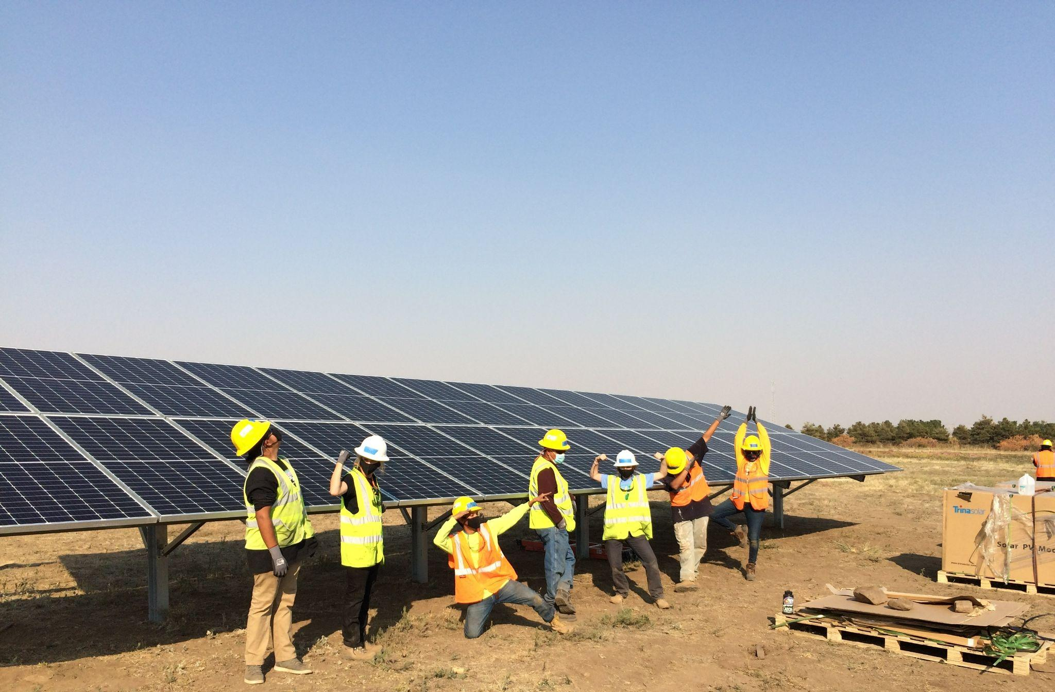
Our Community Solar Work in Action
The Boulder Housing Partners (BHP) Triangle Site Project in Boulder, CO implemented 628 kW-DC through a single ground mount system. The system serves roughly 190 families and offsets their utility bills. A total of 16 trainees worked on the project, with at least 9 Tribal Nations represented among them.

Slide 26
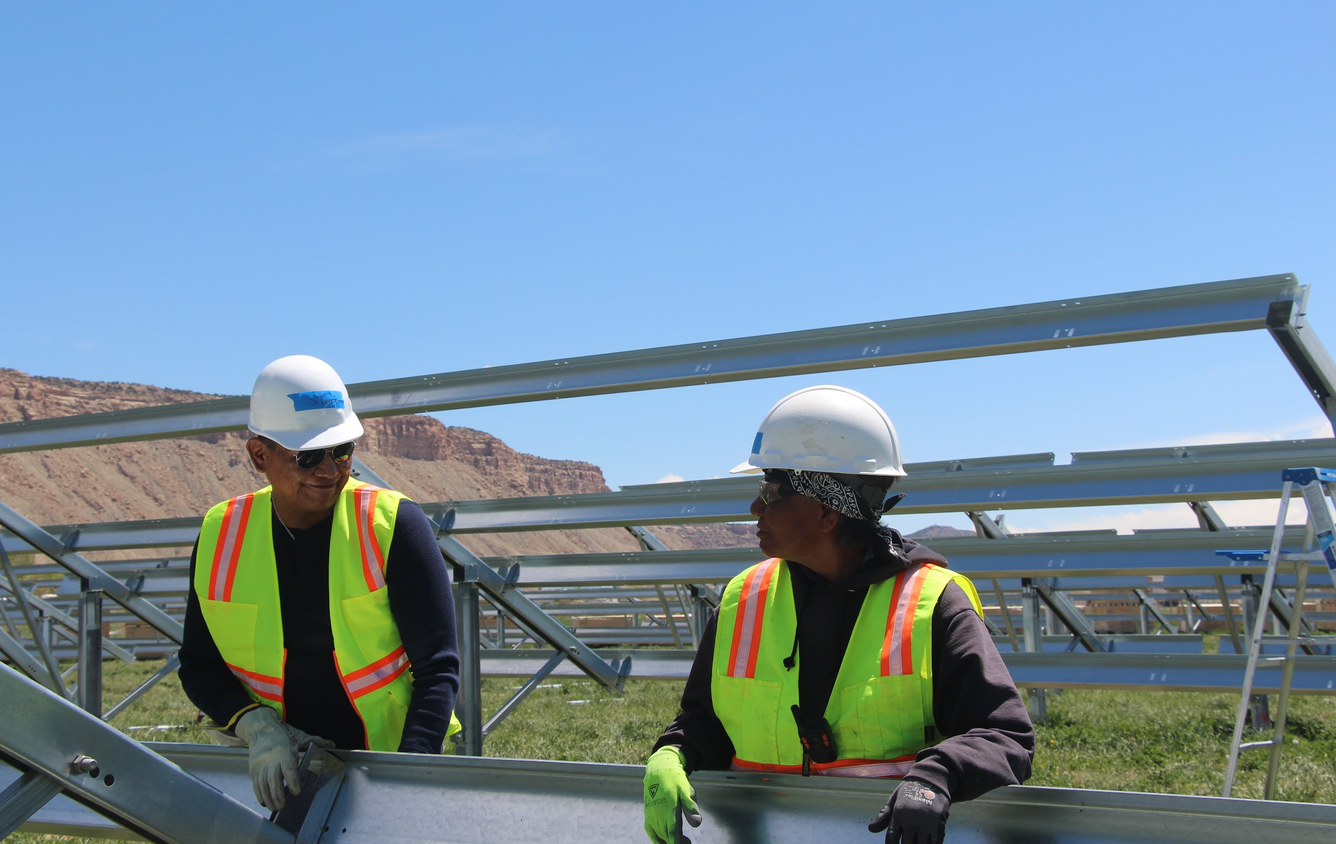
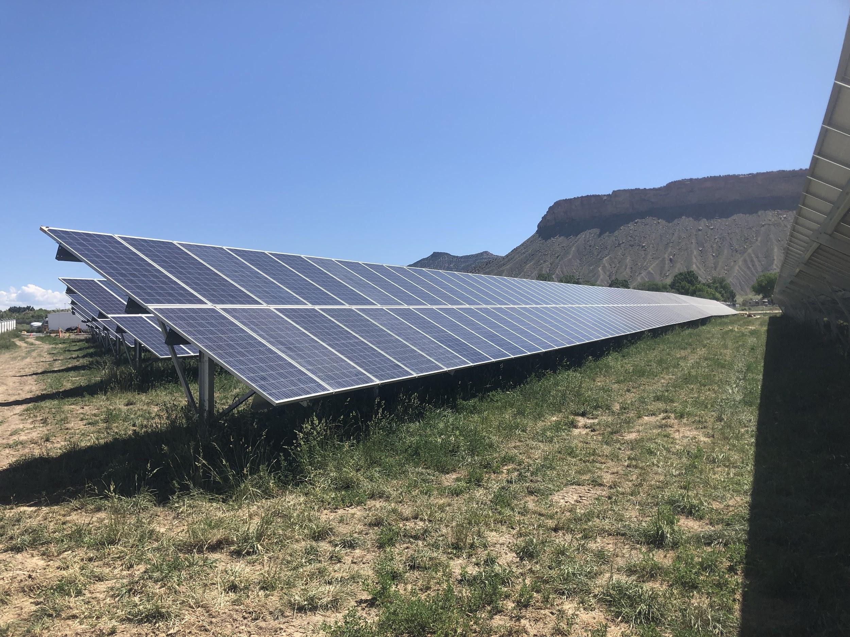
Ute Mountain Ute Tribe & Empire Electric Association
1.2 MW community solar project owned by Ute Mountain Ute Tribe.
GRID Alternatives led DOE application, EPC and workforce development.
Empire Electric (utility) interconnection, power purchase and supporting bill crediting.
Notes:
Providing electricity for 112 Tribal residents, businesses & enterprises
More info:
US Department of Energy, who contributed $973,820 to the project as well as past grants and technical support on renewable energy, energy efficiency and strategic planning; Grid Alternatives, our EPC, who is contributing up to $216,000 in in-kind resources to the project; and Empire Electric Association, our local electric cooperative, who has been very supportive of our project, as well as the volunteers and other Tribal programs that contributed to the workforce development component of the project.

Slide 27
Working with Local Governments:
Roles for Local Governments
Project partner / co-development
Anchor Tenant
Site aggregation
Land Lessee or Seller
Alignment with low-income programming and services
Education and Outreach
Identify community-based-organizations (CBOs)
Other
Notes:
Tom

Slide 28
Santa Fe County: Land Use Issues and Role
Land use regulatory issue
Solutions for Santa Fe County
Role of local government with Community Solar
Notes:
Nate

Slide 29
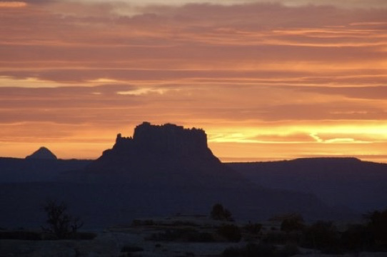
Q&A

Slide 30
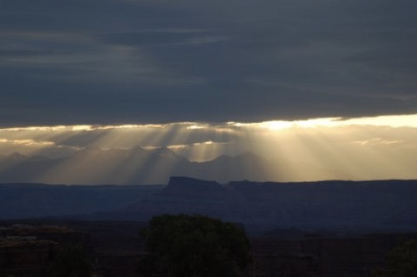
Thank you!

Slide 31
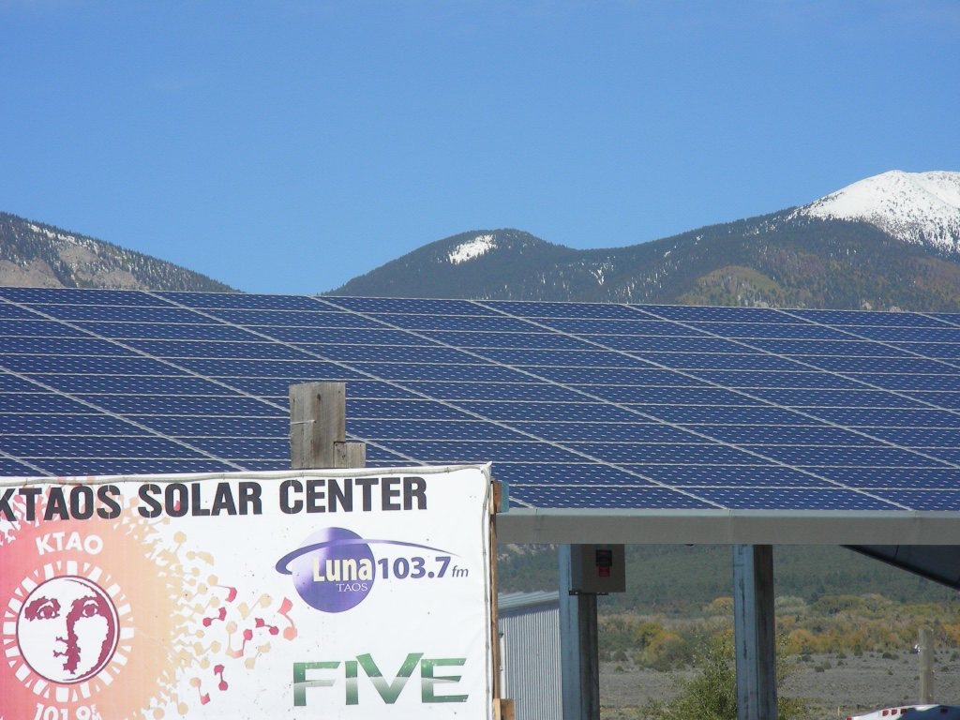
Appendix If needed

Slide 32
Example of Community Solar Savings for Low-Income Households
Electricity Bill without Community Solar Subscription | $130
Electricity Bill with Community Solar (PNM Bill + Community Solar bill) | $49 + $57 = $106
Total Savings this Month | $24 (18%)
New PNM bill
Community Solar bill
Savings!
Notes:
Electricity Bill less generation and distribution costs

Slide 33
State Stakeholder Recommendations
Transparency and clarity
Official NM community solar website
Website should allow CBOs and developers to partner
Provide a model standard contract between developers and CBOs
Accessibility
Self-attestation and pre-qualification should be used to qualify low-income households
Consolidated billing
Developers should offer subscriptions that have no sign-up or cancellation fees, cost escalators, nor credit requirements

Slide 34
Strategy Recommendations for NM

Slide 35
Work with organizations that are trusted
Include local organizations with relationships with a range of community members:
environmental and economic justice organizations,
disability/ independent living centers,
cultural hubs for immigrant and marginalized communities,
educational centers,
state-based/ civic organizations,
faith-based organizations,
family service centers

Slide 36
Fair compensation for partners
Suggested standard contract for CBO partnerships: typical compensation fee ranges for customer outreach, education, enrollment, and ongoing management.
Include a flat fee that would pay the organization for some form of standard training and funds that support capacity building to ensure they can communicate program benefits.

Slide 37
Evolving the pre-qualifying programs
Community Solar Act: The commission shall issue guidelines to ensure the carve-out is achieved each year and develop a list of low-income service organizations and programs that may pre-qualify low-income customers
The list of pre-qualifying programs can/should be updated. It should include:
TANF (Temporary Assistance for Needy Families)
Supplemental Security Income (SSI)
Social Security Disability Insurance (SSDI)
Section 8 Housing
Low-Income units in LIHTC funded housing
The statute states that low-income service organizations can also pre-qualify low-income customers

Slide 38
Recommendations regarding documentation
Final rules require “confirming documentation” for low income households that are not in pre-qualified programs.
State or Federal tax return
Monthly pay stub
Letter from employer(s)
Social Security letters
Unemployment
Documentation will make it onerous for CBOs to securely store private financial information.
Notes:
“A customer who does not qualify under subpart A may provisionally qualify as a low-income subscriber by signing a self-attestation that the customer’s income and household size qualify the customer as a low-income subscriber, until the customer provides sufficient confirming documentation within ninety days of providing the self-attestation.”

Slide 39
Defining low-income service orgs
Current definition is likely too broad. "low-income service organization" means an organization that provides services, assistance or housing to low-income customers and may include a local or central tribal government, a chapter house or a tribally designated housing entity;
Narrowing the definition could be done with:
Providing a definition of services and assistance (e.g., provide housing/shelter, meals, education/training,…), and stipulate that 80% of the organization’s services/assistance is focused on LI households
AND
Provide a list, maintained by program administrator, of organizations that qualify: low-income multifamily housing providers, shelters, food banks/pantries, ...
Notes:
Low-income service organizations need only fit the special definition of this term provided in the community solar act, Section 62-16-2(H), NMSA 1978. From the statute: "low-income service organization" means an organization that provides services, assistance or housing to low-income customers and may include a local or central tribal government, a chapter house or a tribally designated housing entity;
(I) a nonprofit or public housing authority operator where at least 60 percent of the residents meet the eligibility criteria in paragraph 3877(f) and the operator provides verifiable information that these low-income residents are the beneficiaries of the CSG subscription(s); or
(II) a non-profit corporation that is able to demonstrate that it provides essential services including, but not limited to, food, clothing, job training, housing, or medical services primarily to low-income recipients who meet the eligibility criteria set forth in the rules of the Colorado Department of Human Services adopted pursuant to § 40-8.5-105, C.R.S.
(f) "Eligible low-income CSG subscriber" means:(I) a residential customer of a utility who has a household income at or below 185 percent of the current federal poverty level, as published each year in the federal register by the U.S. Department of Health and Human Services; or(II) a residential customer of a utility who otherwise meets the eligibility criteria set forth in the rules of the Colorado Department of Human Services adopted pursuant to § 40-8.5-105, C.R.S.
(g) "Eligible low-income service provider" means:(I) a nonprofit or public housing authority operator where at least 60 percent of the residents meet the eligibility criteria in paragraph 3877(f) and the operator provides verifiable information that these low-income residents are the beneficiaries of the CSG subscription(s); or(II) a non-profit corporation that is able to demonstrate that it provides essential services including, but not limited to, food, clothing, job training, housing, or medical services primarily to low-income recipients who meet the eligibility criteria set forth in the rules of the Colorado Department of Human Services adopted pursuant to § 40-8.5-105, C.R.S.
4 Colo. Code Regs. § 723-3-3877

Slide 40
Website run by program administrator
Ethical code of conduct regarding standards of engagement for both Developers and CBOs for all orgs that want to be listed in searchable database
Project Search: Filter with terms/conditions from different projects so CBOs could search for the best developers for partnership
CBO Search: Developers can search for interested CBOs based on capacity, experience, and desired roles
Users could leave reviews about experiences with developers & CBOs for increased transparency and accountability (like Yelp or Amazon)

Slide 41
Low Income program facilitator
Similar to OR and CO programs
Organization that works with program administrator, focused on education, outreach, enrollment of low-income households
Supporting low-income subscribers with additional services, like energy efficiency, signing up for LIHEAP, etc.

Slide 42
Ongoing Review
Low-Income Working Group to review program issues and seek to develop solutions
Include organizations that work directly with low-income communities
Compensate them for their participation

Slide 43
Refining Rules for Implementation

Slide 44
How many LI subscribers can we expect?
Assume developers will respond to maximize RFP criteria regarding low-income participation
30% carveout
Could be up to 50% based on current RFP criteria, represents 100 MW of capacity
40% or which goes to “direct-billed”, 40 MW of capacity. Assume a 3.5 kW subscription / household based
up to 11,400 low-income households
60% to low-income service providers, 60 MW of capacity, can roughly assume 30 kW average subscription
up to 2,000 LI service organizations
Native Community Solar projects? Could have more LI subscribers
Notes:
RFP language:
(a) a bid including a commitment to exceed the statutory 30-percent minimum level of subscription of low-income subscribers shall be awarded 2 points for each additional 5-percent commitment above the 30-percent minimum, up to a maximum of 8 points for a commitment to a 50-percent low-income subscription level for the proposed project;
(b) a bid including a commitment to serve a specific percentage of direct-billed low-income customers shall be awarded 4 points for a 10-percent commitment and 2 additional points for each additional 10-percent commitment, up to a maximum of 8 points for a commitment to a 40-percent subscription level of direct-billed, low-income subscribers for the proposed project;

